Slide 1

Isn’t a sunrise more beautiful than a sunset?
Ex-ante assessments of professional regulation and the new
Proportionality Test Directive (EU)2018/958

Slide 2
Sunrise vs sunset approach
Sunrise assessment of regulation
Coherent and complete ex-ante assessment
Sunset review of regulation
Review after introducing the measure
Regulatory reforms
Based on facts
Enforcement
Public interest objectives

Slide 3
Mutual Evaluation
The range of regulated professions (over 5500 different regulations in MS)
The variety in intensity / approaches taken
The analysis provided as to proportionality - (incomplete, superficial, not fact based)

Slide 4
To address these shortcomings
Services Package – 10 January 2017
  Reform Recommendations on regulation in professional services
  Proportionality test directive

Slide 5
Proportionality Test- Legal Basis
TFEU
  Fundamental freedoms
  Principle of proportionality
Case Law, including:
  C-55/94 Gebhard (restriction) …
Existing Union law, namely:
  Professional Qualifications Directive

Slide 6

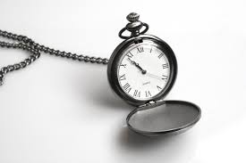

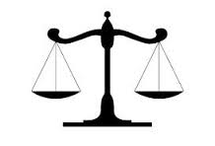
Proportionality test – What's in it?
Criteria– clarity and common approach case law
Preventative – sunrise rather than sunset
Understanding risks and effects
Transparency
Evidence led
Information exchange – best practice
Combined effects
Periodic review/ modernisation

Slide 7
Requirements
Reserves of activities/protected professional title
Restriction on joint exercise of profession
Minimum/maximum tariffs
Organisation of profession
CPD
Compulsory membership in professional organisation
Language
Quantitative restrictions
Legal form / shareholding requirements
Advertising requirements
Territorial restrictions
Insurance

Slide 8
Ex-ante assessment
Risks related to public interest objectives | √ / X
Existing rules insufficient for the attainment of the objective pursued | √ / X
Effect of the provision when combined with existing provisions | √ / X
Connection between scope of activities/reserves of activity and the professional qualification required; complexity | √ / X
Whether/why reserves of activities can/cannot be shared with other professions | √ / X
Scientific and technological developments | √ / X

Slide 9
Transparency before and after new measures are adopted
  Involvement of stakeholders
    Not just those that are members of the profession concerned
  Member States encouraged to exchange information with other Member States
  Reasons why new provisions are justified and proportionate to be made publicly available

Slide 10
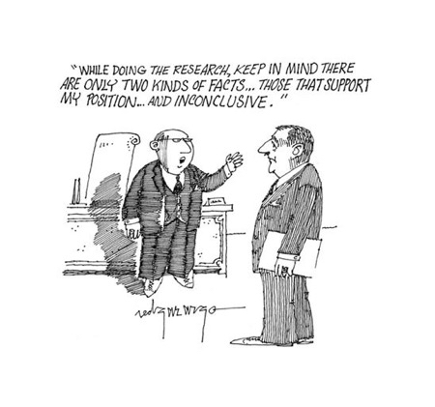
Facts – and figures
  Evidence based
    based on specific qualitative and, wherever possible, quantitative data
    art of the possible
    general conjecture not sufficient
    no special form but plausible, not necessary to prove that no other means possible
  Objective and independent
    Possibility to involve independent bodies

Slide 11
It is all about getting the balance right
- protect public interest
- prevent unjustified barriers
- improve quality of regulation
- ensure a level playing field

Slide 12
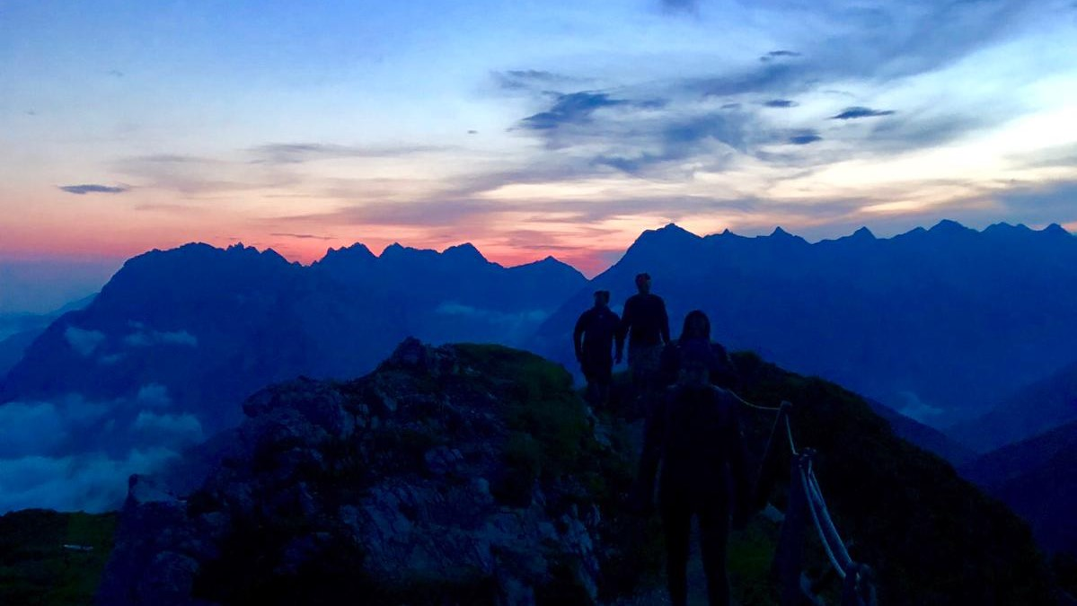
A journey to beautiful sunrises!

