Slide 1

Quality management system in The Netherlands
Bernard de Leest
Member of the general council of the
Netherlands Bar (NOvA)

Slide 2
Topics
Legal Practice Area Register
Quality Assessment

Slide 3
Legal Practice Area Register
1-1-2019: Introduction Legal Practice Area Register
Purpose
  Enhance quality
  Accessibility & transparency for clients

Slide 4
Legal Practice Area Register
Transparent
35 Legal Practice Areas
General Practice
Sub categories
Dynamic self learning system

Slide 5
Obligations
Obligation for every registered lawyer, after finishing vocational training
Minimum 1 – maximum 4 Legal Practice Areas
10 CE points per legal practice area per year

Slide 6
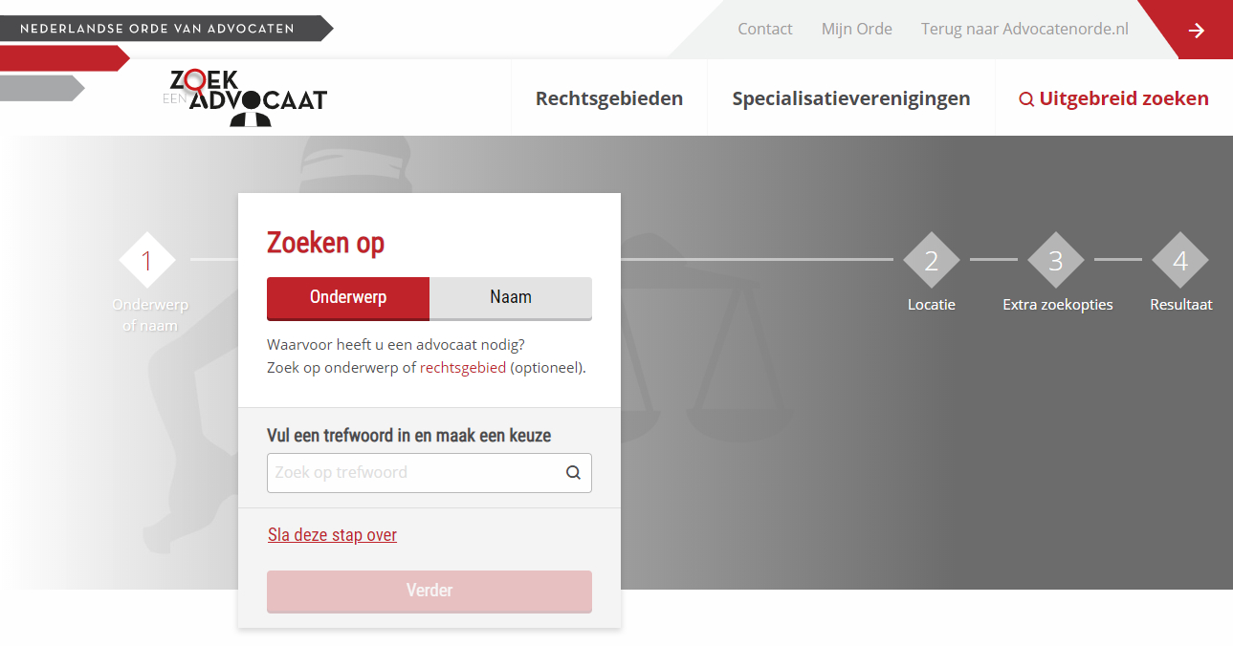
Search Engine

Slide 7
Quality Assessment
Legal basis: article 26 Act on Advocates
  General council responsible for assessing quality of registered lawyers
  Quality assessment scheme incorporated in bye law on the profession
Legislation to enter into force in 2020
Purpose: to enhance quality of service

Slide 8
Quality Assessment
Compulsory for registered lawyers
Quality enhancement, not supervision
Choice between:
  Peer review
  Intervision
  Structured inter-collegial consultation

Slide 9
Peer Review
Appointed reviewer ( = registered lawyer)
At least 4 hours per year
Review of at least 5 cases
Findings discussed between reviewer and reviewed lawyer

Slide 10
Peer Review
Reviewer issues short report stating that review has taken place and short description of the discussions that took place
Confidentiality guaranteed
Costs borne by reviewed lawyer
Max 4 CE points

Slide 11
Intervision
Minimum 3 – max 10 registered lawyers
Chaired by expert appointed on the basis of art. 26 Act on Advocates
Same legal practice areas
1-2 cases per participant

Slide 12
Intervision
At least 8 hours per year (minimum 2 – max 4 consecutively)
Confidentiality guaranteed
Proof of participation and short report on proceedings to be provided by chair.
Costs borne by participants
Max 4 CE points

Slide 13
Structured inter-collegial consultation
Minimum 3 – max 10 registered lawyers
Chaired by one of the participants
Same legal practice areas
1-2 questions per participant

Slide 14
Structured inter-collegial consultation
At least 8 hours per year (minimum 2 – max 4 consecutively)
Confidentiality guaranteed
Proof of participation and short report on proceedings to be provided by chair.
No CE points

