Slide 1
Behavioural Insights and public policy
An international perspective
Filippo Cavassini, Economics Department, OECD
Joint CCBE-FBE Conference: Self-regulation and Quality in the Legal Profession
Lisbon, 25 October 2019

Slide 2

Question 1
  Have you snoozed the alarm clock in the morning at least once in the course of this week?

Slide 3
Applying insights from behavioural sciences to public policy

Slide 4
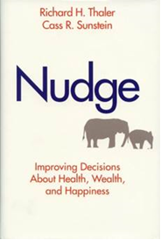
Nudging
“any aspect of the choice architecture that alters people’s behaviour in a predictable way without forbidding any options or significantly changing their economic incentives.”
(Thaler and Sunstein 2008, p. 6)

Slide 5
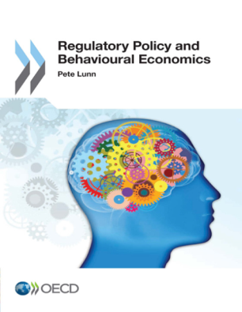
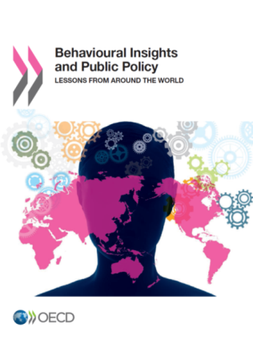
Behavioural economics and behavioural insights (BI)
BEHAVIOURAL ECONOMICS
BEHAVIOURAL INSIGHTS
Behavioural Economics is the application of the inductive scientific method to the study of economic behaviour
Lessons derived from the behavioural and social sciences, including decision making, psychology, cognitive science, neuroscience, organisational and group behaviour, which are being applied by public bodies with the aim of making public policies work better
Often involves the use of experiment and observation to identify patterns of behaviour and use these findings to inform policies and regulation
It is about inductive approach to policy-making

Slide 6

Question 2
  Have you ever bought a travel insurance without knowing and/or without wanting to buy it?

Slide 7
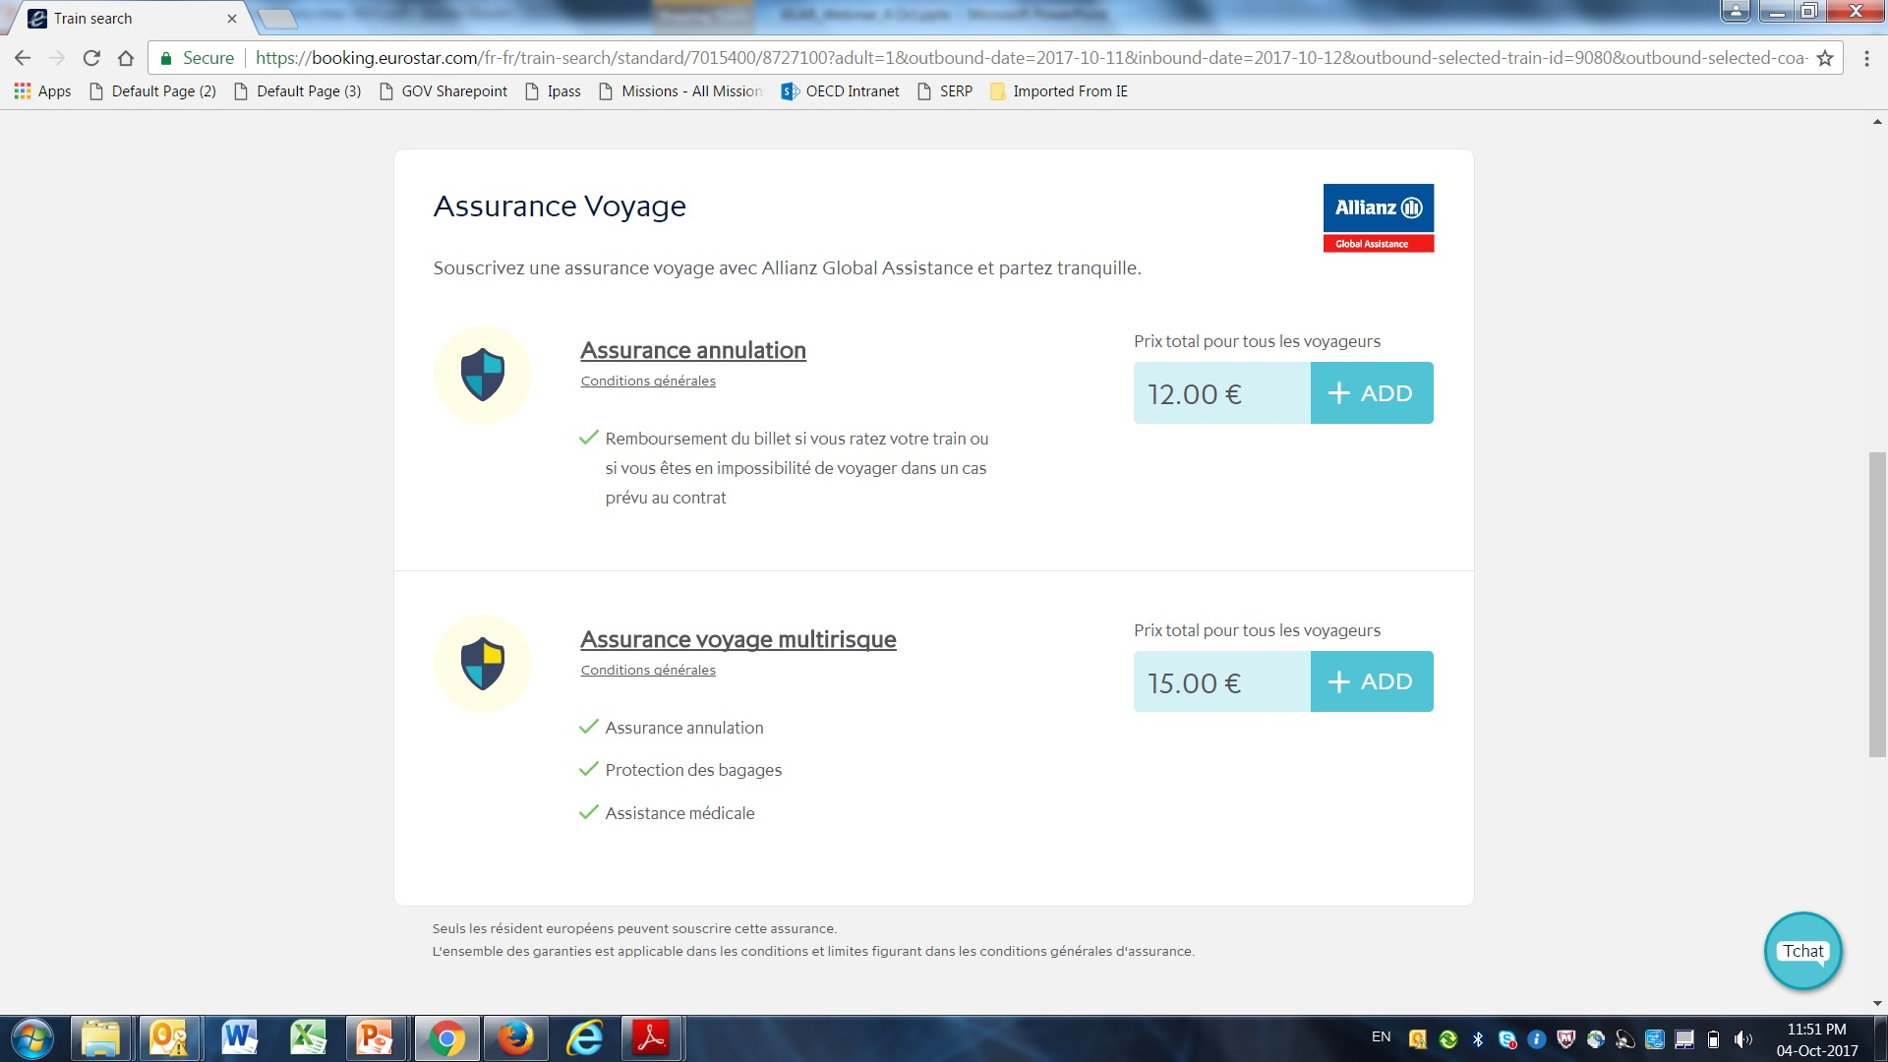
EU Consumer Protection Directive - defaults

Slide 8

Question 3
  Have you read from the beginning to the end the contract for your mobile phone/communication services subscription?

Slide 9
User behaviour – Colombia communications market
OECD (2016), Protecting Consumers Through Behavioural Insights, OECD Publishing.

Slide 10
Too much information…
Reduction in cognitive ability by 10-20%
OECD (2016), Protecting Consumers Through Behavioural Insights, OECD Publishing.

Slide 11

What does this mean for regulators and service providers?
Disclosure
Choice Aids
Full
Checklists
☒
☑
☑
☑
☒
☒
Summary
Regulate or not to Regulate?
Reduce Choices
“Just in time”
$$$?
OECD (2016), Protecting Consumers Through Behavioural Insights, OECD Publishing.

Slide 12
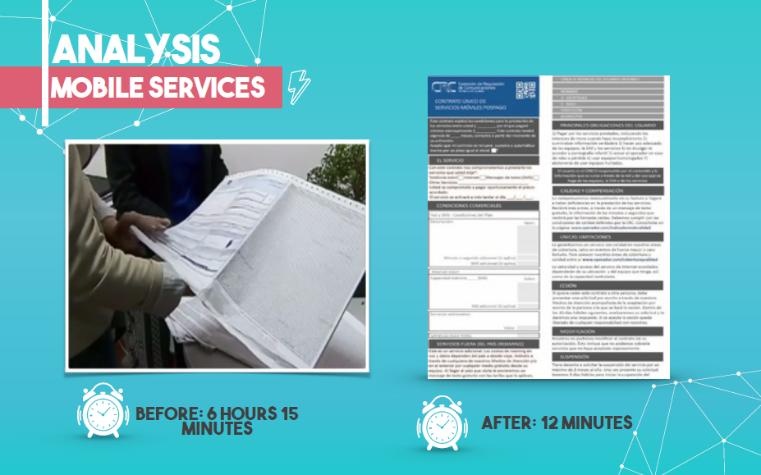
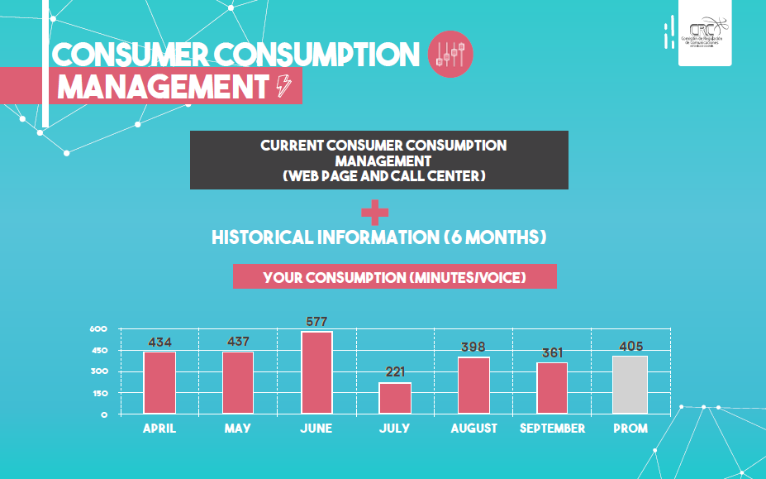
OECD (2017), “Impact Update: Protecting Consumers Through Behavioural Insights.”

Slide 13

Question 4
  Do you see potential for applying behavioural insights to your profession?

Slide 14
Organisational behaviour – cartel behaviour
Research Questions
Managers Incentives: Are individual fines more effective than corporate fines at deterring cartels?
Labour Market: Do different regulatory regimes impact the type of contracts managers are offered? (contracts with fixed salary vs fixed+variable component)

Slide 15
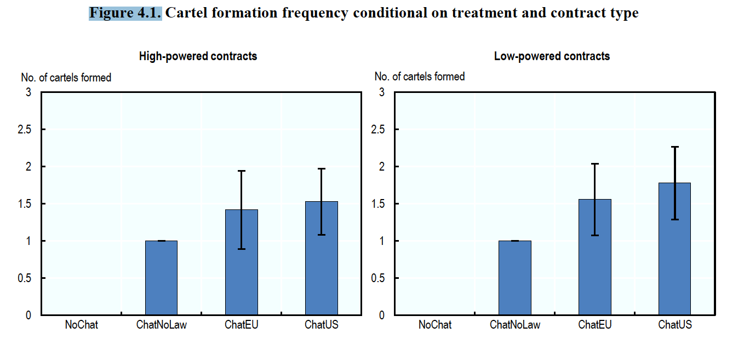
Theory – experiment gap
Type of fines does not impact managers’ decision to collude
OECD (2019), Delivering Better Policies Through Behavioural Insights: New Approaches, OECD Publishing.

Slide 16

Take-aways (I)
  BI is not a silver bullet
    Not all problems are behavioural
    It is ultimately about encouraging, assisting or making better decisions by individuals and organisations
    What is a “better decision” should be well understood by public bodies

Slide 17
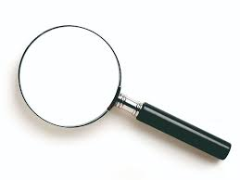
Take-aways (II)
  BI approach helping pre-test different policy options
    understanding how people actually react and behave in different situations
    anticipating the behavioural consequences of actions and interventions

Slide 18
Thank you!
filippo.cavassini@oecd.org
@filippocavassi1

