Slide 1
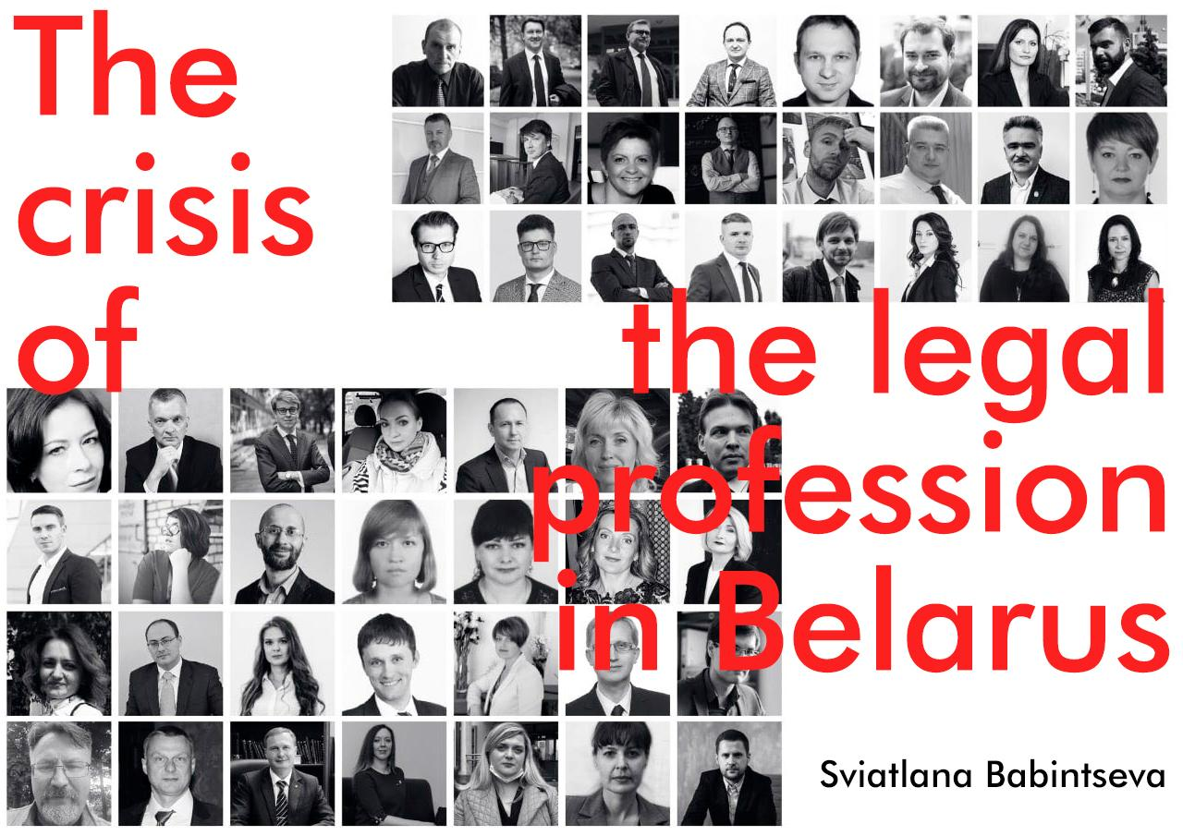

Slide 2
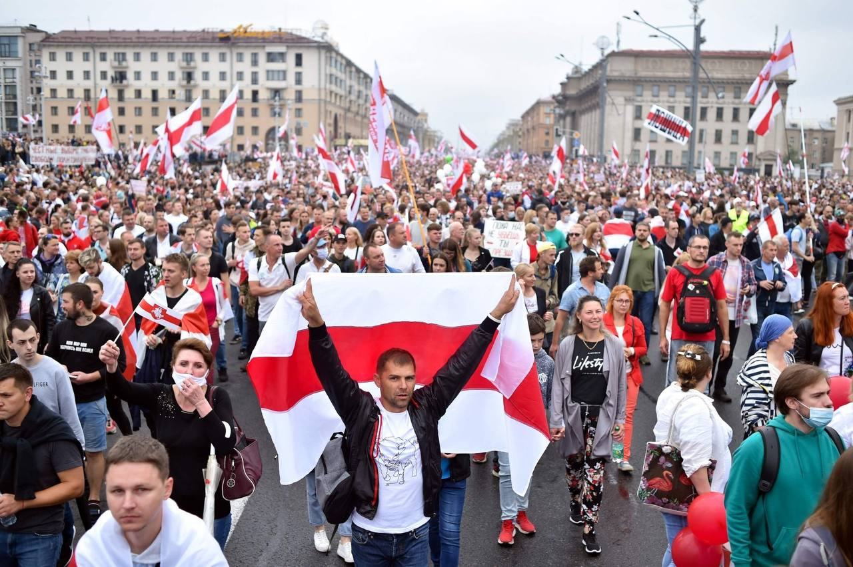
Political crisis of 2020
Fraud in the presidential elections and protests in the country
The extreme level of violence
The repression is still going on.
1400 political prisoners (per 10 million population)

Slide 3
The situation with the legal profession in Belarus
73 lawyers are deprived of the right to a profession.
At least 6 lawyers are deprived of their liberty.
At least 250 lawyers resigned from the Bar Association
1 lawyer per 5,000 population

Slide 4
The Ministry of Justice as a licensing authority has the authority to:
conduct inspections of bar associations, individual advocates;
initiate disciplinary proceedings against the advocate and suspend him/her from performing professional duties for the duration of the disciplinary proceedings;
carry out attestation of advocate;
terminate the advocate's license.

Slide 5
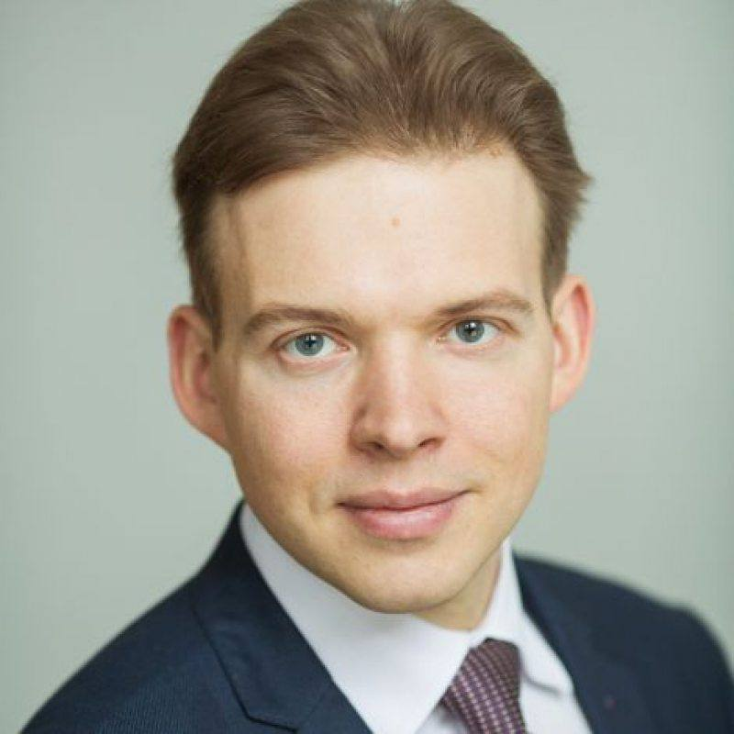
Advocetes persecuted
Prosecution of advocates for activities
Intimidation of advocates
Activity interference
Photo of advocate Maxim Znak serving 10 years in prison

Slide 6
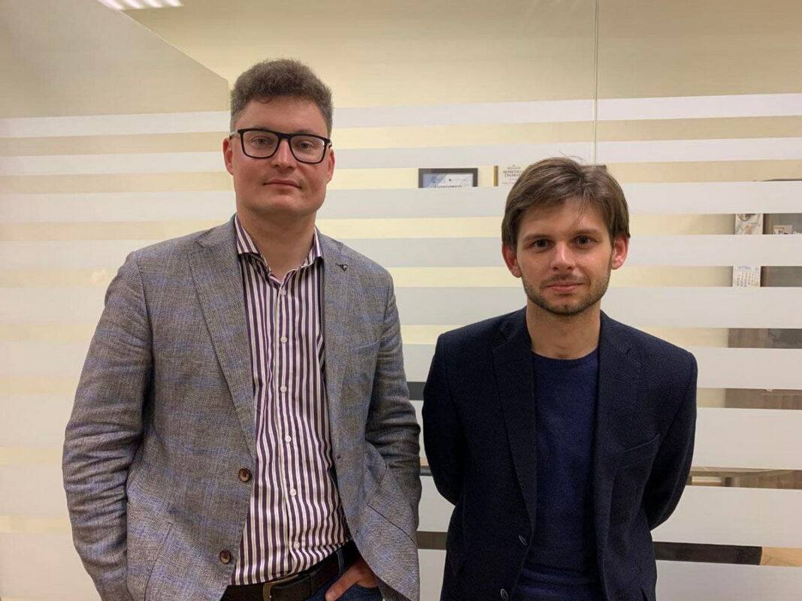
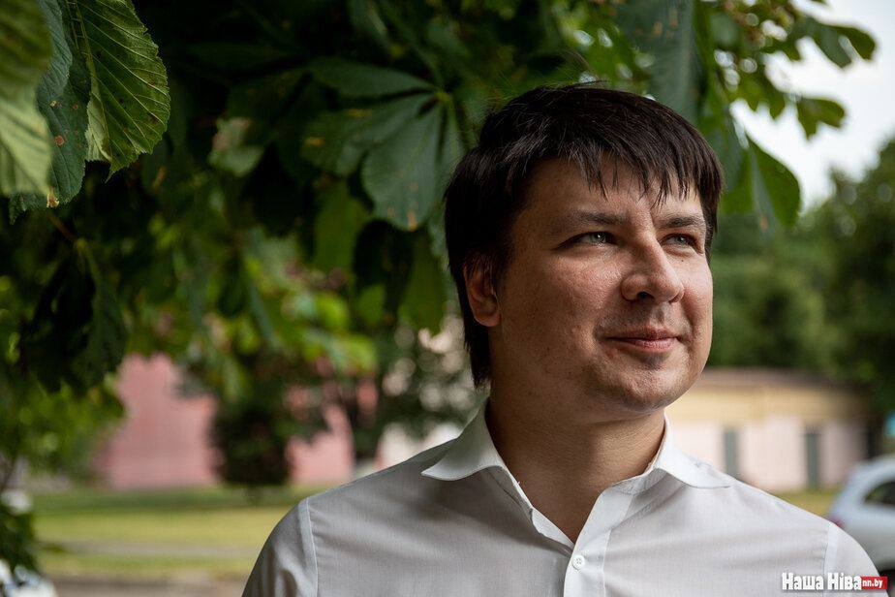
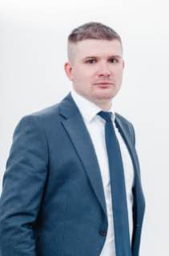
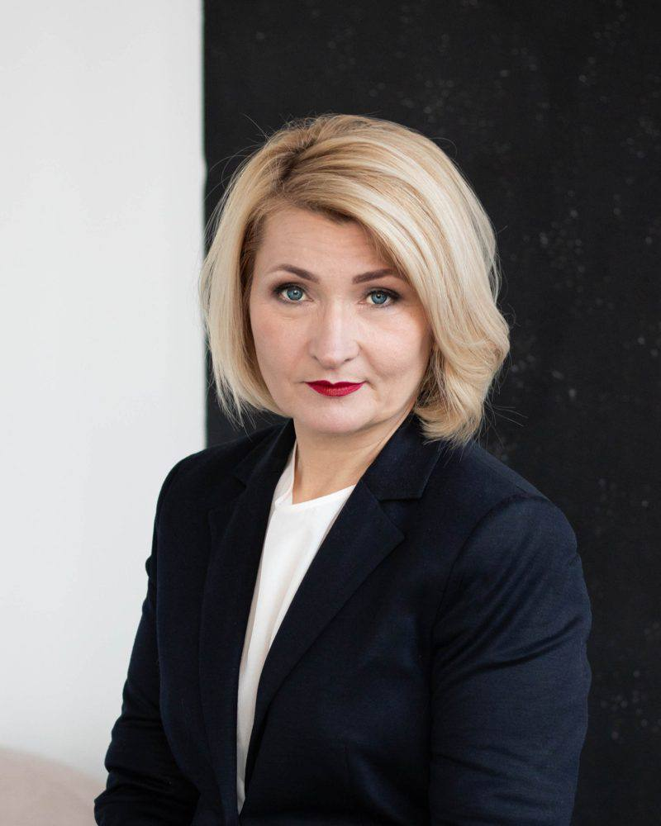
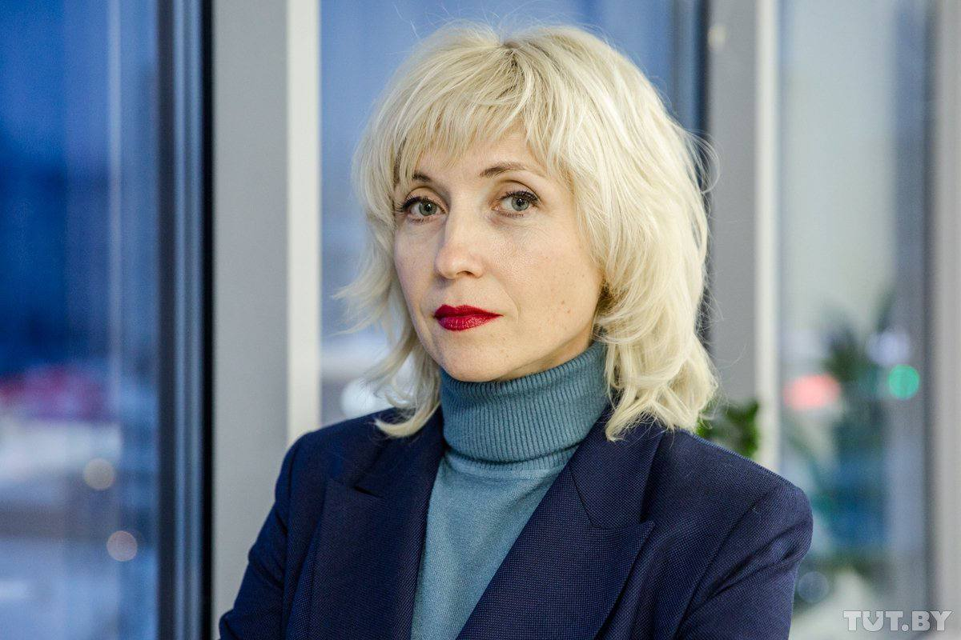
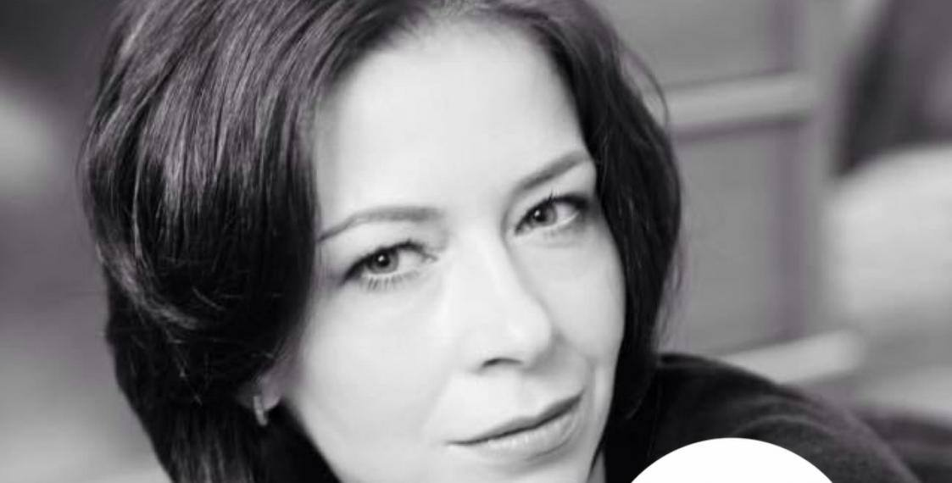
Deprivation of the right to the profession
Revocation of a license
Attestation
Disciplinary Procedures
Notes:
Слайд на 0,5 минуты
Подчеркнуть, что все эти процедуры выполняются подчиненными людьми. Отразить унизительный характер аттестации, которую не проходят phD и академики.

Slide 7
Conclusions
Advocates in Belarus lack independence and are under the control of the Ministry of Justice.
Violation of the procedural rights of advocates and the right to defend their clients is becoming critical.
Advocates in Belarus are subjected to repressive practices that are incompatible with the guarantees of their professional activities.
Advocates work in an atmosphere of fear and/or constant risk of being denied the right to practice for actively defending a client or being subjected to other harassment, including criminal prosecution.
Bar associations in Belarus do not meet the essential features of a professional association of advocates- independence, self-governance and self-regulation, they have turned into a kind of state bodies, and don't fulfill their tasks of protecting the rights of advocates.
Since such conditions are incompatible with the effective defending of people, the right of citizens to protection has been devalued.

Slide 8
What can international and foreign professional associations do?
Do not recognize Belarusian bar associations as professional associations that would represent Belarusian lawyers!
Recognize the status of advocates, who are deprived of the right to practice in Belarus!
Distribute information about the crisis of the legal profession in Belarus (report)!

Slide 9
defendersbelarus@protonmail.com
TG @defenderbelarus
www.defenders.by
eng version https://www.defenders.by/right_to_protection

Slide 10
Thank you for your attention!

