Slide 1
WOMEN MAKING HISTORY
OF THE FBE

Slide 2
SARA CHANDLER
2017–2018
Former President of the City of Westminster and Holborn Law Society
Sara is a solicitor in London South Bank University’s Legal Advice Clinic, where she trains and supervises law students to give free legal advice to members of the public.
In 2016, Sara was made Honorary Queen’s Counsel (now King’s Counsel) for her work in human rights, pro bono and as a pioneer of clinical legal education.

Slide 3
2002–2021
2005–2010
2010–2022
2018–2022
2017–2022
Member of the Council of the Law Society of England & Wales
Member of the International Human Rights Committee of the Law Society of England & Wales
Member of the Human Rights Committee of the Law Society of England & Wales
Chair of Equality, Diversity & Inclusion Committee of the Law Society of England & Wales
Member of the International Committee of the Law Society of England & Wales
Other Law Society roles:
Chair of the Young Solicitors Group
Chair of the Housing Committee
Chair of the Human Rights Committee
Member of the Law Reform Board
Member of the Regulatory Affairs Board
Director and Trustee of the Law Society Charity

Slide 4
2002–2003
2006–2007
2019–2022
2008–2022
President of the South London Law Society
President of the Westminster & Holborn Law Society
Law Centre Network Board of Trustees
Director of the Colombia Caravana International Network of Support for Human Rights in Colombia

Slide 5
SILVIA GIMÉNEZ-SALINAS COLOMER
2019–2021
ExDecana del Ilustre Colegio de Abogados de Barcelona
Spanish advocate. Since 2001 is an expert in Family Mediation, with a special concern for the rights of child protection.
She was appointed Dean of the Bar Association of Barcelona in office from 2005 to 2009.

Slide 6
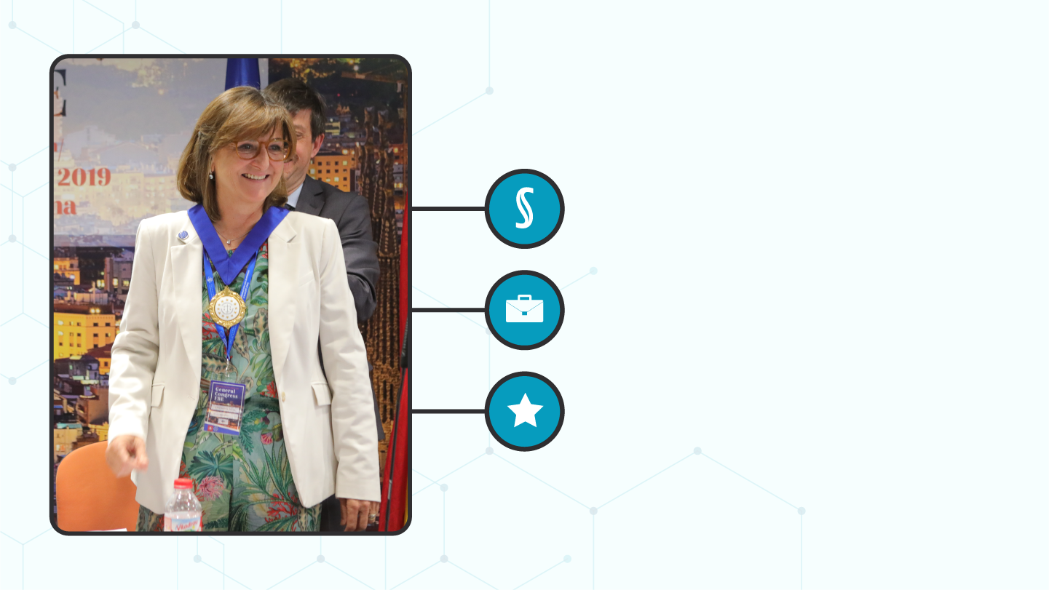
Member of the Plenary Commission Codification of Catalonia
President of the Research Institute of Applied Law
Former President of the Fédération des Barreaux d'Europe (FBE)

Slide 7
In her work as a teacher, she has participated in the Master of Law in the field of family law.
During her long career, she has chaired various prestigious organizations in the world of the Law, such as:
the Council of the Bar Associations of Catalonia (CICAC),
Commission for Relations with the Justice Administration of the General Council of the Spanish law (CGAE),
Intercol·legial Catalan Association,
Catalan Arbitration Association,
Commission for Relations with the Administration of Justice in the Barcelona Bar Association (ICAB).

Slide 8
DOMINIQUE ATTIAS
2021–2022
Ancienne Vice-Bâtonnière du Barreau de Paris
Dominique is an attorney at law registered at the Paris Bar since 1981. Partner at SCP Attias & Jauze Avocats in Paris, Dominique specialises in real estate, family, and juvenile law.
Dominique was decorated as Chevalier of the Légion d’Honneur.

Slide 9
2009–2015
2016–2017
2018–2020
2019–now
Member of the French National Bar Council (CNB)
Vice-President of the Paris Bar, in charge of international relations and access to law and justice
Member of the Council of the Paris Bar, sat on the International Relations Commission and the Europe/Central Europe Subcommittee
Administrator on the Board of Directors of the International Conference of Bars with a Common Legal Tradition (CIB)

Slide 10
Dominique is very involved in the rights of women, particularly lawyers, and led a list called “women and law” in professional elections in 2012.
She was also an expert of the Access to Justice Committee of the Council of Bars and Law Societies (CCBE) for many years.
In March 2021, Dominique became the President of the European Bars Federation (FBE). She served in this capacity until June 2022.

Slide 11
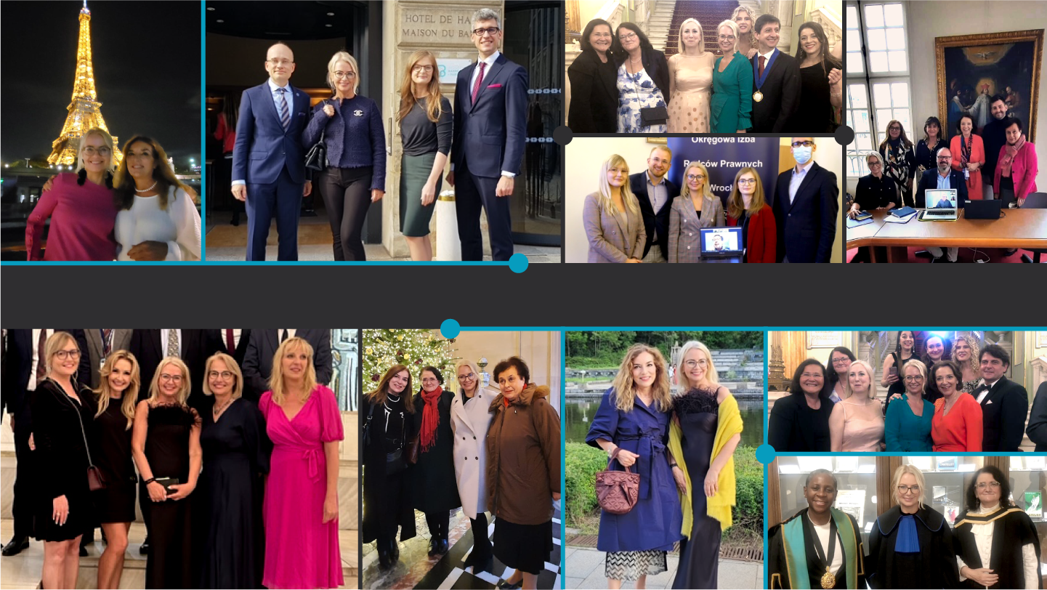
WOMEN OF THE EUROPEAN BARS FEDERATION (FBE)

Slide 12
THANK YOU
FOR YOUR ATTENTION

