Slide 1
Professional secrecy under the tech side: The unseen danger
Ludmila Glembotzky Goya

Slide 2
OVERVIEW OF THE PRESENTATION
Regulatory framework
Practical issues

Slide 3
REGULATORY FRAMEWORK

Slide 4
REGULATORY FRAMEWORK
Code of Conduct for European Lawyers, CCBE.
Article 2.3 Confidentiality
“It is of the essence of a lawyer’s function that the lawyer should be told by his or her client things which the client would not tell to others, and that the lawyer should be the recipient of other information on a basis of confidence. Without the certainty of confidentiality there cannot be trust. Confidentiality is therefore a primary and fundamental right and duty of the lawyer.
The lawyer’s obligation of confidentiality serves the interest of the administration of justice as well as the interest of the client. It is therefore entitled to special protection by the State.
A lawyer shall respect the confidentiality of all information that becomes known to the lawyer in the course of his or her professional activity. The obligation of confidentiality is not limited in time.
A lawyer shall require his or her associates and staff and anyone engaged by him or her in the course of providing professional services to observe the same obligation of confidentiality.”

Slide 5
REGULATORY FRAMEWORK
IBA International Principles on Conduct for the Legal Profession
Article 4 Confidentiality/Professional Secrecy
“A lawyer shall at all times maintain and be afforded protection of confidentiality regarding the affairs of present or former clients, unless otherwise allowed or required by law and/or applicable rules of professional conduct.”

Slide 6
REGULATORY FRAMEWORK
Regulation (EU) 2016/679 of the European Parliament and of the Council of 27 April 2016 on the protection of natural persons with regard to the processing of personal data and on the free movement of such data, and repealing Directive 95/46/EC (General Data Protection Regulation).

Slide 7
PRACTICAL ISSUES

Slide 8
PRACTICAL ISSUES
Security lock
How to create a secure password?
Combine numbers (1,2,3…), letters (a,B,c …) and symbols (@,?,$...)

Slide 9
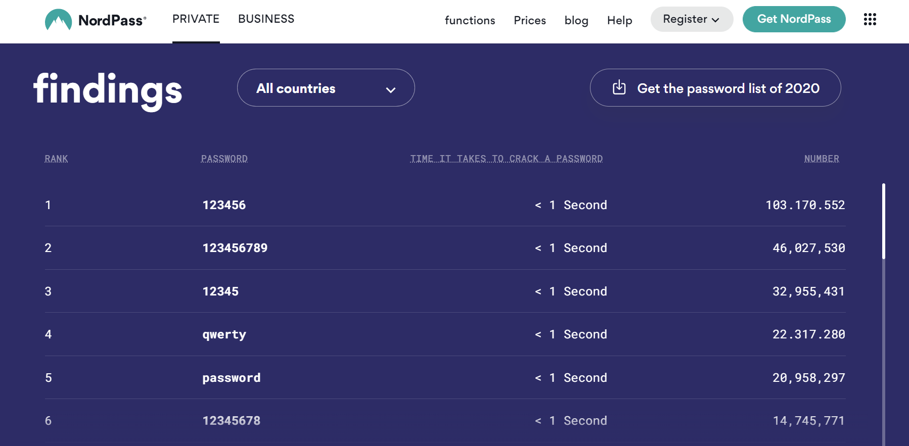

Slide 10
PRACTICAL ISSUES
Information storage (cloud, server, portable hard disk)

Slide 11
Cloud storage
Better to use a cloud storage hosting data located in Europe to avoid collision between the US Patriot Act and RGDPR.

Slide 12
Server
It allows several people (from different devices) to access the same location where the documentation is stored, being able to access it from anywhere.

Slide 13
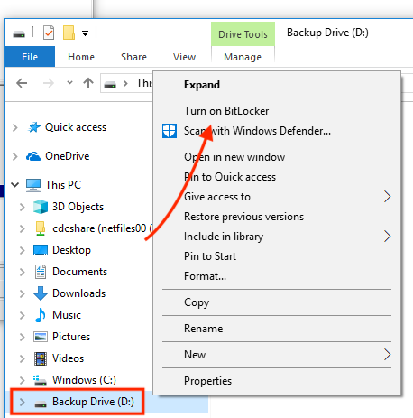
External hard drive

Slide 14
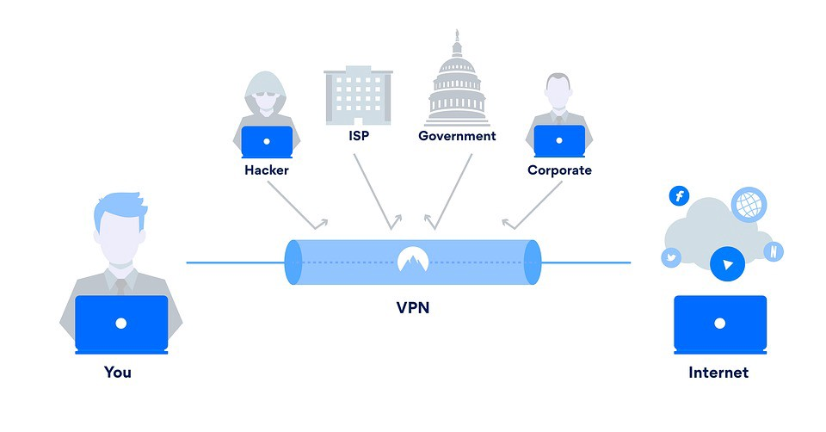
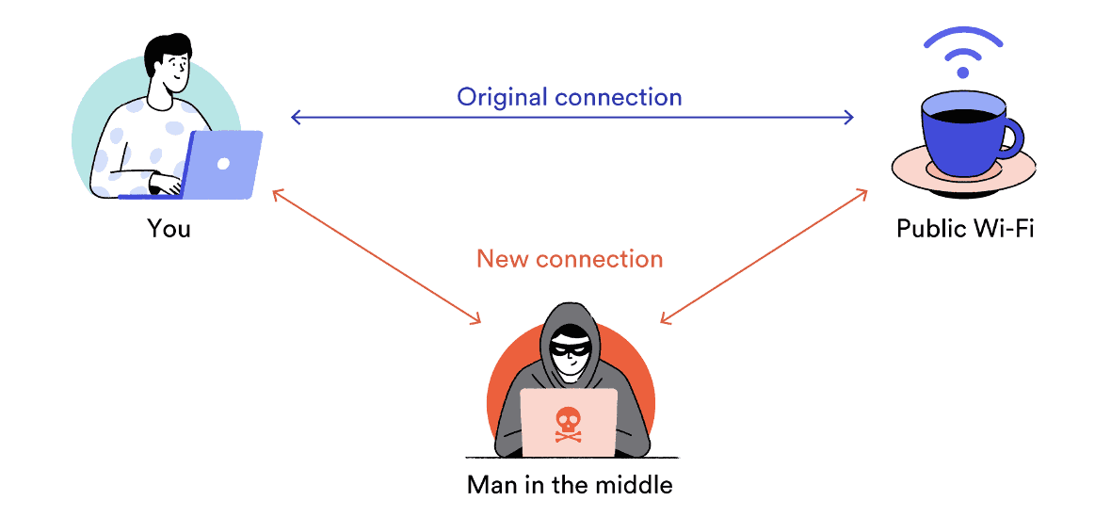
PRACTICAL ISSUES
Wi-Fi, VPN

Slide 15
PRACTICAL ISSUES
Social Media
IBA International Principles on Social Media for the Legal Profession
Article 4 Confidentiality
“It is important that lawyers can be trusted with private and confidential information, and that the public perceive this. Bar associations and regulatory bodies should remind lawyers that social media platforms are not appropriate for dealing with client data or other confidential information unless they are fully satisfied that they can protect such data in accordance with their professional, ethical and legal obligations.
In addition, bar associations and regulatory bodies should encourage lawyers to consider client confidentiality more generally when using social media. For example, information that locates a lawyer geographically and temporally could be used to show professional involvement with a client who does not wish to publicise that he or she is seeking legal advice. Even the use of hypothetical questions or anonymous fact patterns may inadvertently reveal confidential information. More specifically, they should call attention to the relevant rules of professional conduct in their jurisdiction.”

Slide 16
A month preparing for this meeting and I'm almost late because I stained my tie.

Slide 17
Not protecting adequately our devices could lead to a breach in our obligation to maintain professional secrecy.

Slide 18
Thank you
Ludmila Glembotzky Goya
Bilbao-Biscay Bar Association
ludmila.glembotzky@dominion-global.com
Ludmila Glembotzky Goya
Member and Secretary of the FBE New Technologies Commission

